Slide 1

VARDHMANJEWELS1985
Instagram Report
BRAND
PERIOD
COMPARISON PERIOD
CHANNEL
@vardhmanjewels1985
18 Jun 2026 - 17 Jul 2026
19 May 2026 - 17 Jun 2026
Instagram

Slide 2

Vardhman Jewels
EXECUTIVE SUMMARY
2/12
Between June 18 and July 17, VardhmanJewels' Instagram activity showed a decrease in most engagement metrics despite maintaining a consistent posting schedule, with 12 posts made during this period compared to 18 previously. The follower count updated to 4,973, establishing the community size during this timeframe.Engagement per post and daily averages dropped significantly, reflecting lower interaction levels, with likes and comments also following this downward trend. Reach and impressions nearly halved compared to the previous period, which impacted overall exposure and engagement rates.Video views fell sharply from over 19,000 to 3,559, indicating less traction on video content. Additionally, the earned media value and awareness contributions decreased notably, showing diminished earned media effectiveness.However, the use of hashtags per post slightly increased, possibly as an effort to enhance discoverability even though the overall reach fell.
Source: Socialinsider
Date range: 18 Jun 2026 - 17 Jul 2026

Slide 3
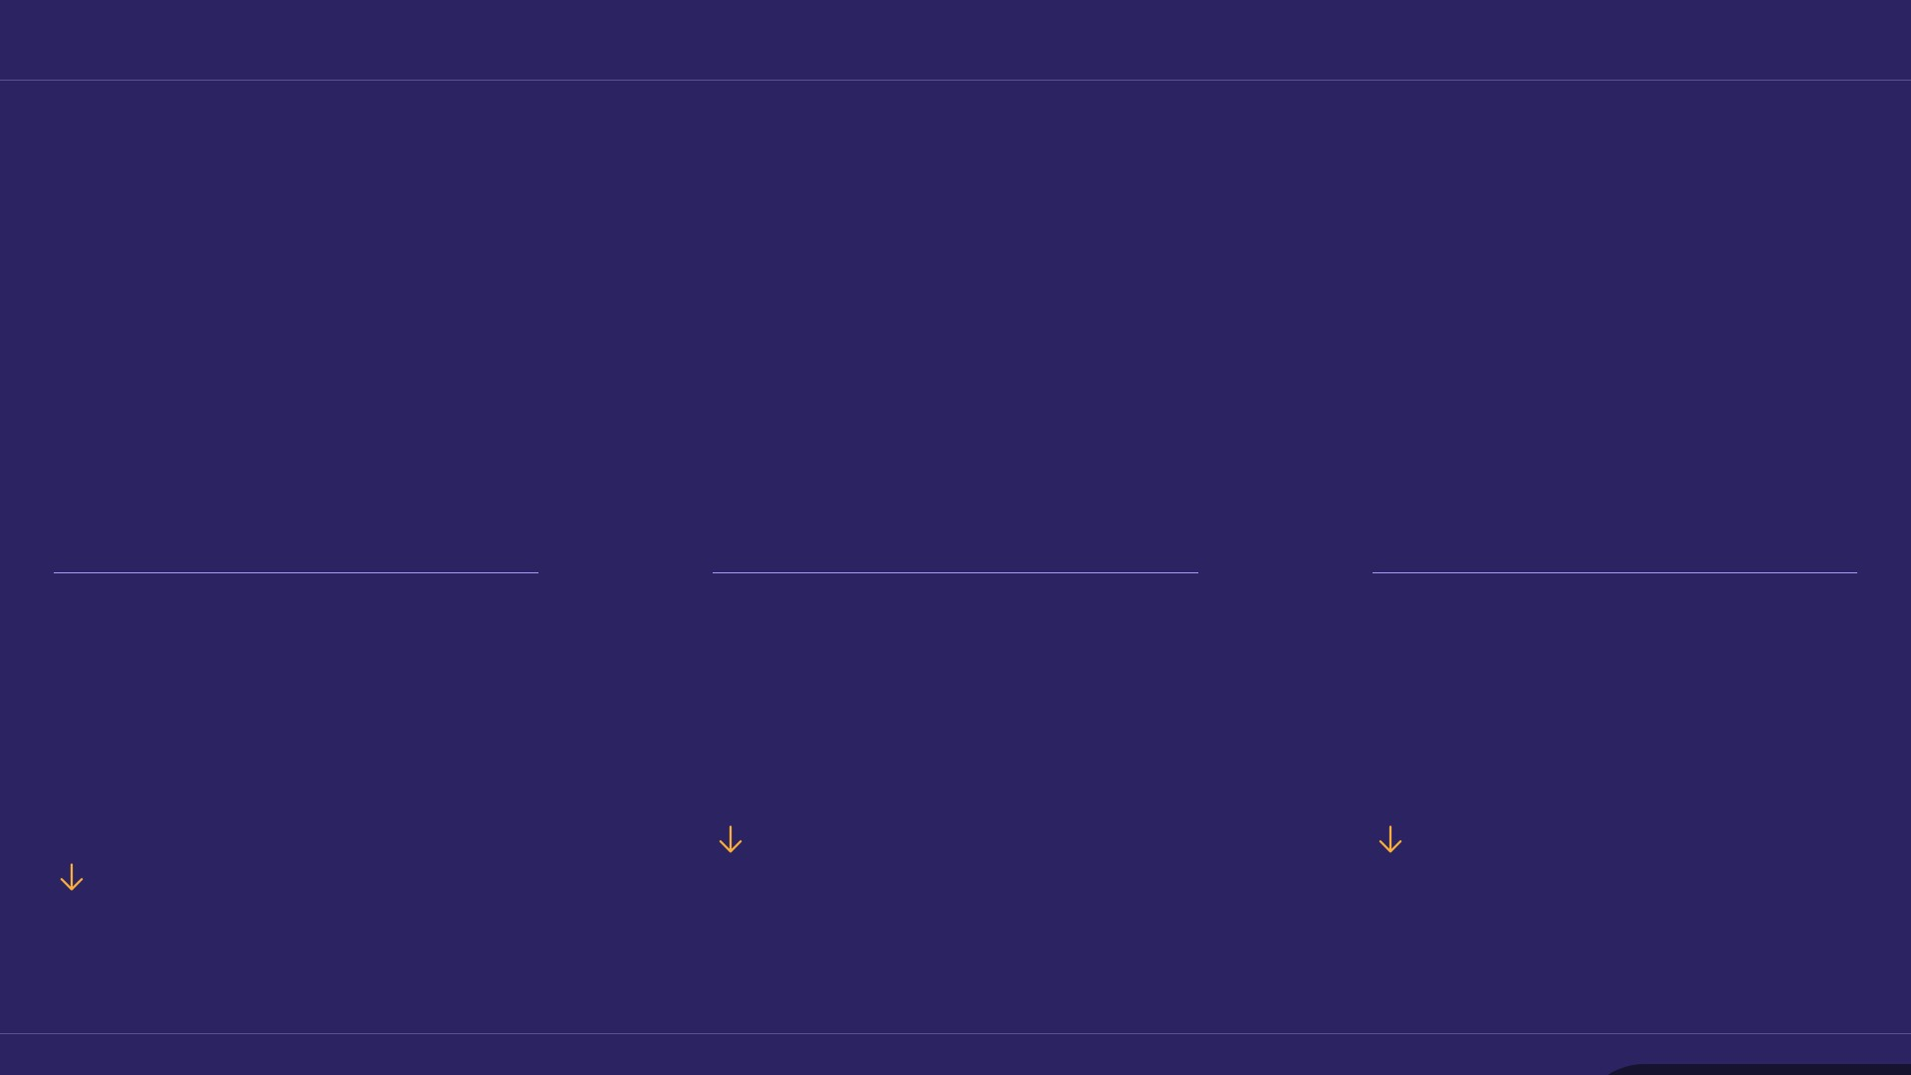
KEY INSIGHTS
3/12
One month, three numbers
A quieter period — most metrics didn't gain as much traction as before.
0.18 %
8,130
6,372
Avg. Engagement Rate by Followers
Organic Posts Views
Organic Posts Reach
61.22%
53.07%
57.77%
Source: Socialinsider
Date range: 18 Jun 2026 - 17 Jul 2026

Slide 4
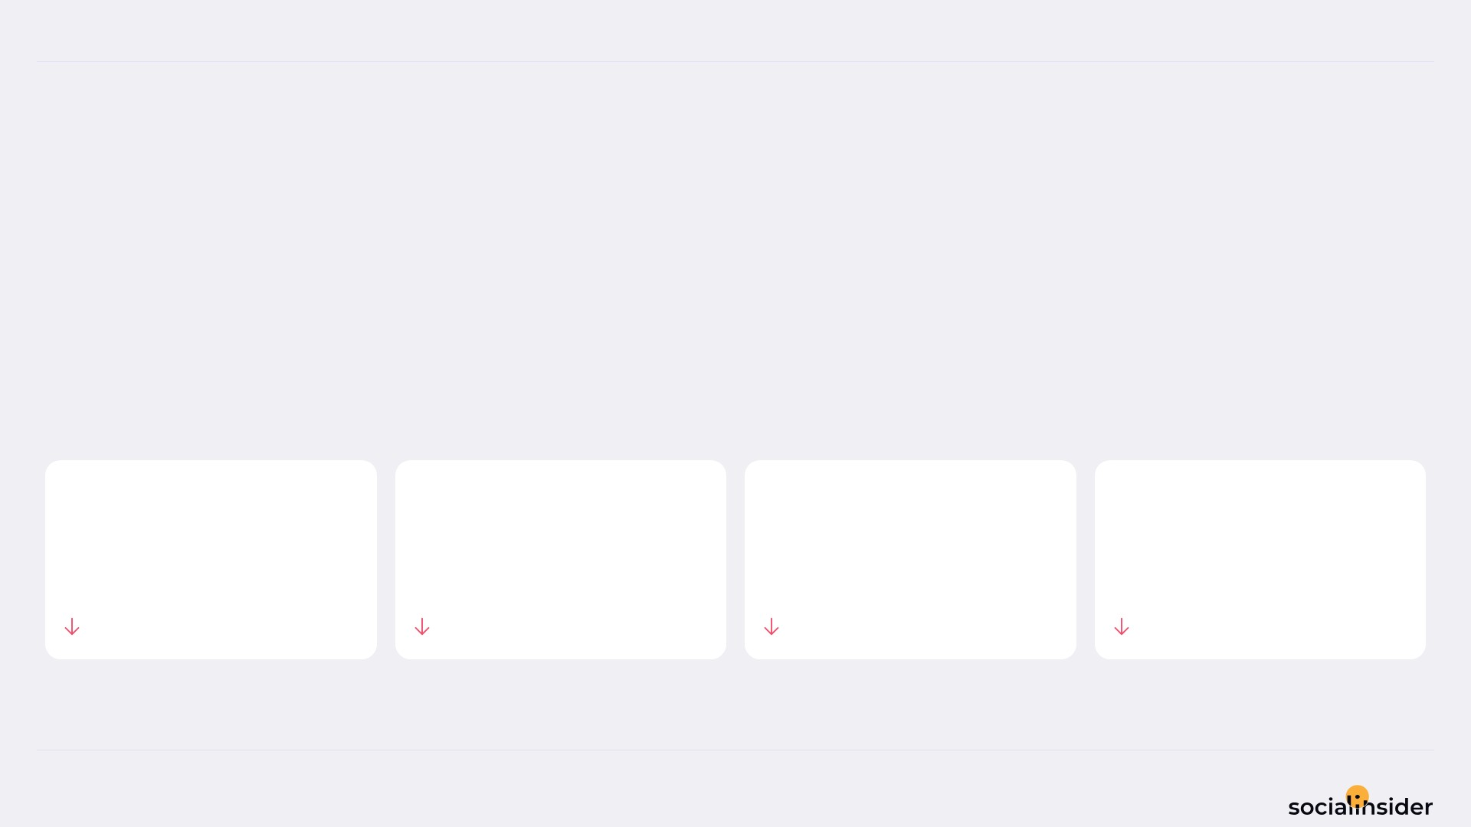
Vardhman Jewels
POSTS PERFORMANCE
4/12
POSTS TO ENGAGEMENT
We posted 33.33% less, and engagement followed.
TOTAL POSTS
TOTAL ENGAGEMENT
AVG ENGAGEMENT / POST
AVG ENGAGEMENT / DAY
12
105
8.8
3.5
33.33%
71.85%
57.77%
71.85%
Source: Socialinsider
Date range: 18 Jun 2026 - 17 Jul 2026

Slide 5
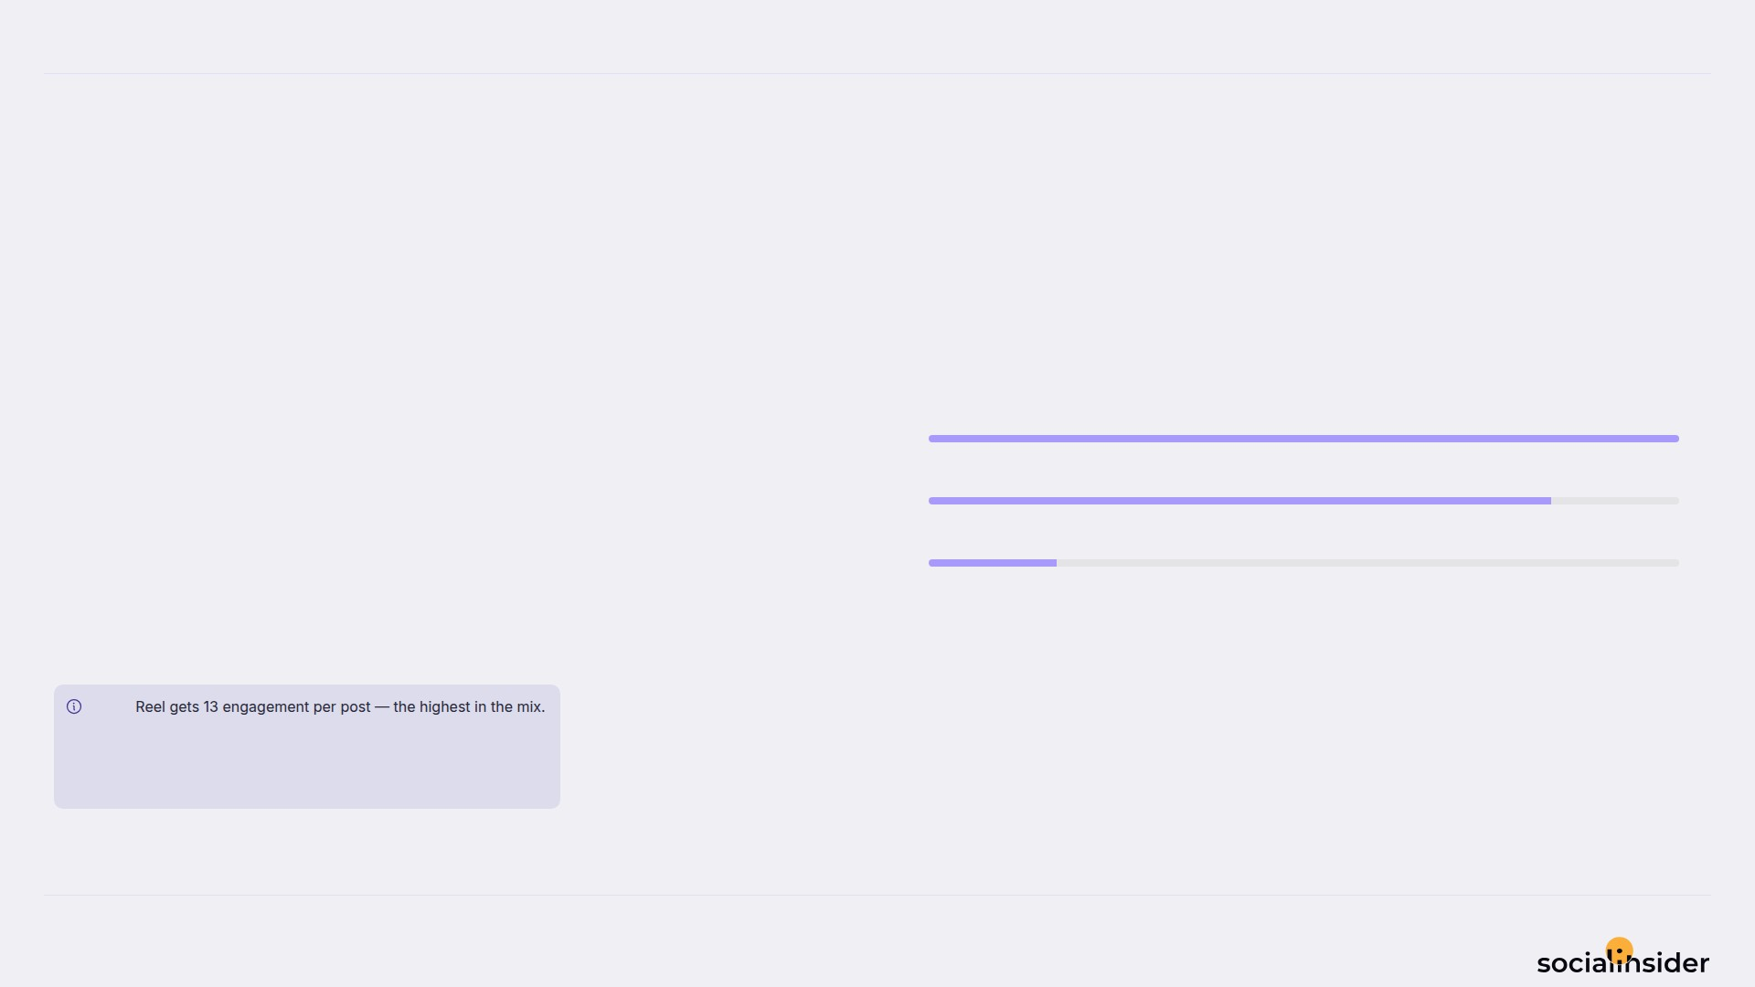
Vardhman Jewels
5/12
WHAT WE PUBLISHED
Image made up the majority of posts published during this period. Reel drove the results.
Image
6
Reel
5
Carousel
1
Image accounted for 50% of posts and 29% of engagement.
Note
Source: Socialinsider
Date range: 18 Jun 2026 - 17 Jul 2026

Slide 6
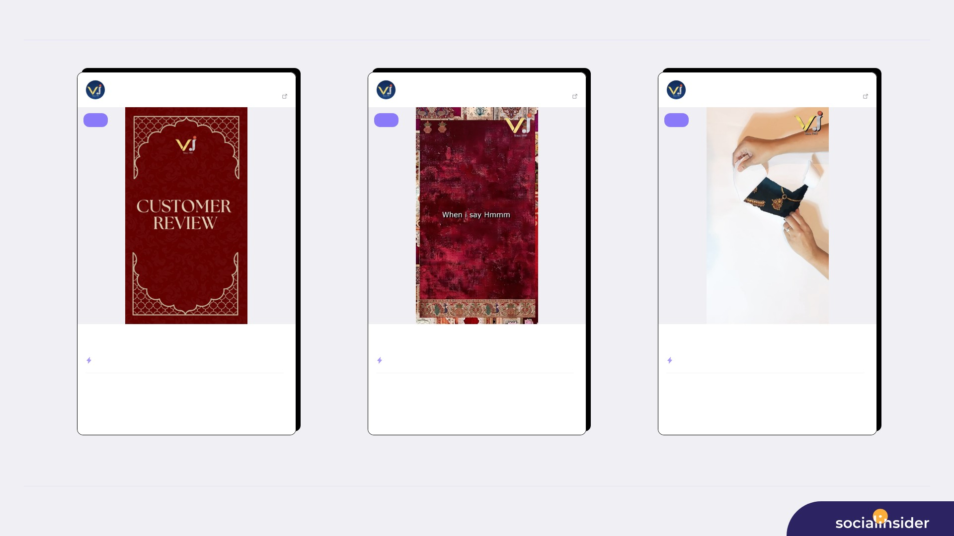
TOP CONTENT
6/12
Vardhman Jewels
Jun 25, 2026
Vardhman Jewels
Jul 06, 2026
Vardhman Jewels
Jul 07, 2026
4973 followers
View post
4973 followers
View post
4973 followers
View post
reel
reel
reel
✨ Real stories, pure trust! ✨ (Vardhaman Jewels customer review, best...
If you know , you know. That “hmm” isn’t just a sound ; it’s the sound...
✨ The wait ends here. Unveiling our newest jewellery collection—crafte...
ENGAGEMENT RATE
0.48%
ENGAGEMENT RATE
0.30%
ENGAGEMENT RATE
0.24%
930
23
476
14
801
12
VIEWS
LIKES
VIEWS
LIKES
VIEWS
LIKES
1
579
1
297
0
499
COMMENTS
REACH
COMMENTS
REACH
COMMENTS
REACH
Source: Socialinsider
Date range: 18 Jun 2026 - 17 Jul 2026

Slide 7
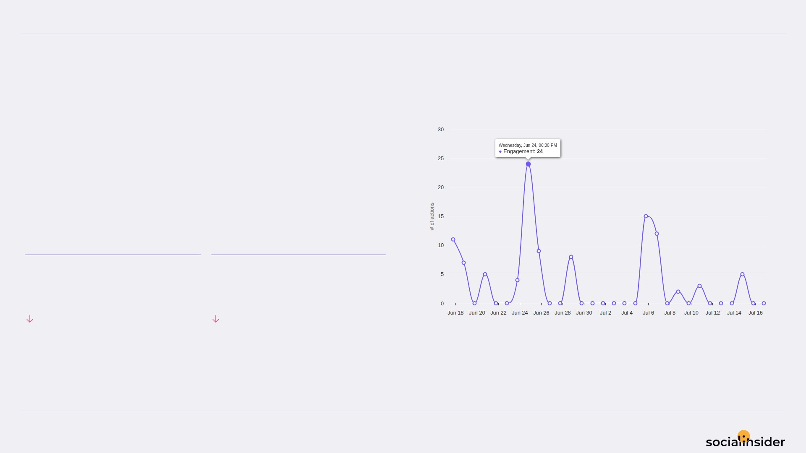
Vardhman Jewels
ENGAGEMENT
7/12
Engagement trend over the selected period
102 Total Organic Likes — a volatile period.
Both Total Organic Likes and Total Organic Comments declined this period.
TOTAL ORGANIC LIKES
TOTAL ORGANIC COMMENTS
102
3
71.67%
76.92%
Source: Socialinsider
Date range: 18 Jun 2026 - 17 Jul 2026

Slide 8
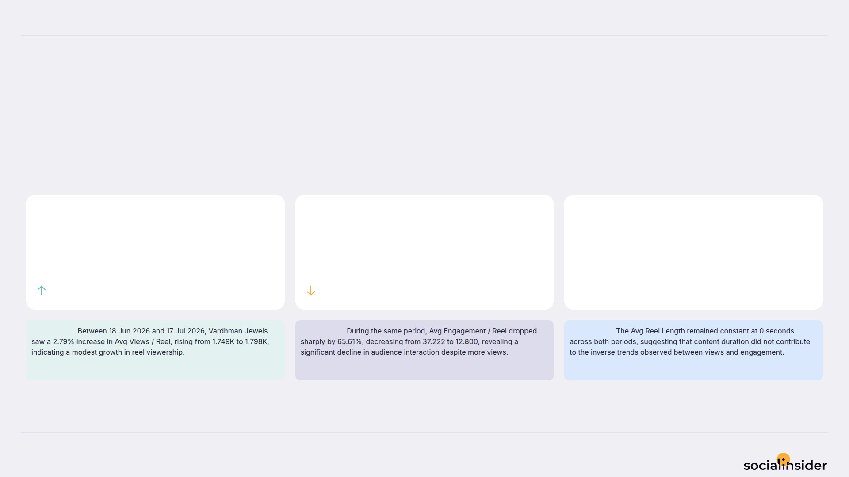
Vardhman Jewels
REELS
8/12
Key metrics for reels published during the period
Reels was mixed — some metrics increased while others decreased.
AVG VIEWS / REEL
AVG ENGAGEMENT / REEL
AVG REEL LENGTH
1.8
12.8
0
2.79%
65.61%
0%
Observation:
Observation:
Observation:
Source: Socialinsider
Date range: 18 Jun 2026 - 17 Jul 2026

Slide 9
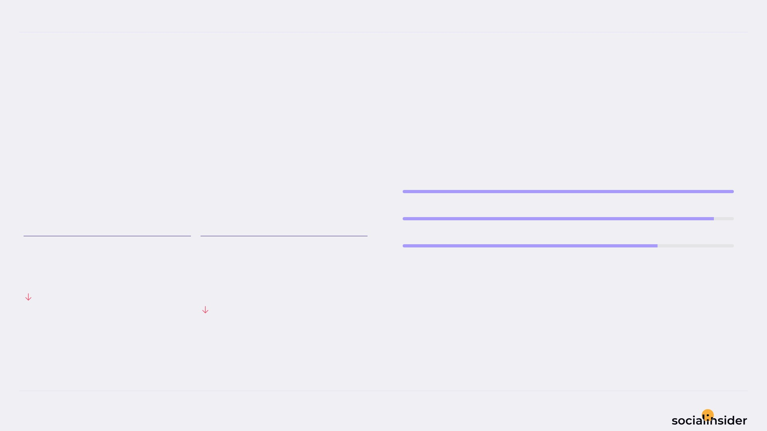
Vardhman Jewels
REACH
9/12
Reach performance broken down by post type
531 Avg Reach / Post — declining this period.
Both Avg Reach / Post and Avg Engagement Rate by Reach declined this period.
Image
2K
Reel
2K
Carousel
2K
AVG REACH / POST
AVG ENGAGEMENT RATE BY REACH
531
3.1
%
53.07%
10.43%
Source: Socialinsider
Date range: 18 Jun 2026 - 17 Jul 2026

Slide 10
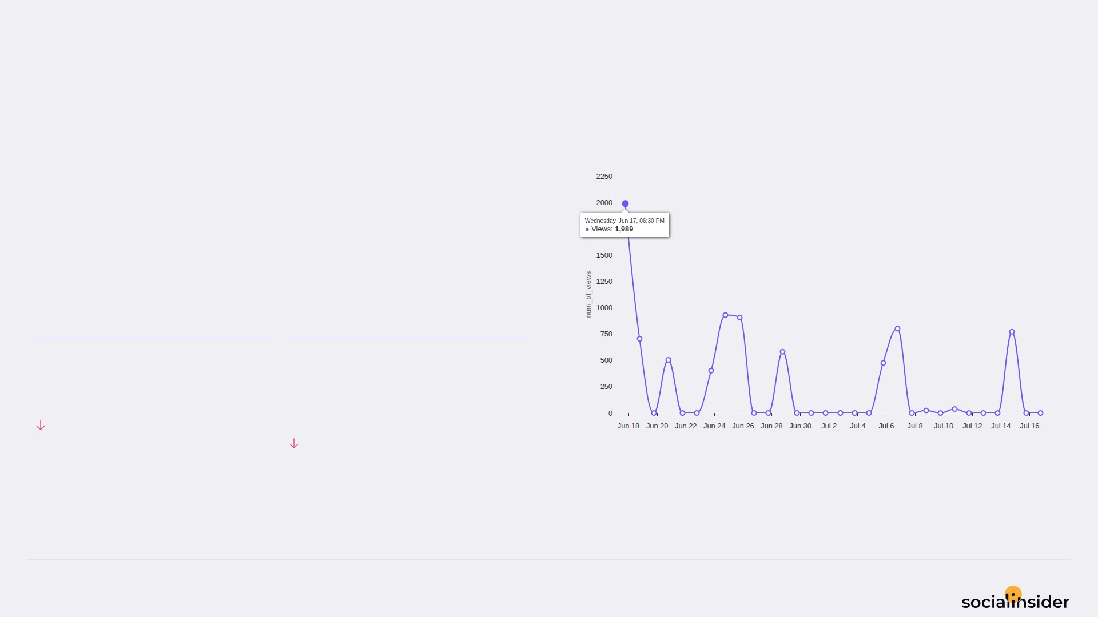
Vardhman Jewels
VIEWS
10/12
Views performance
677.5 Avg Views / Post — a volatile period.
Both Avg Views / Post and Avg Engagement Rate by Views declined this period.
AVG VIEWS / POST
AVG ENGAGEMENT RATE BY VIEWS
677.5
2.5
%
41.83%
11.35%
Source: Socialinsider
Date range: 18 Jun 2026 - 17 Jul 2026

Slide 11
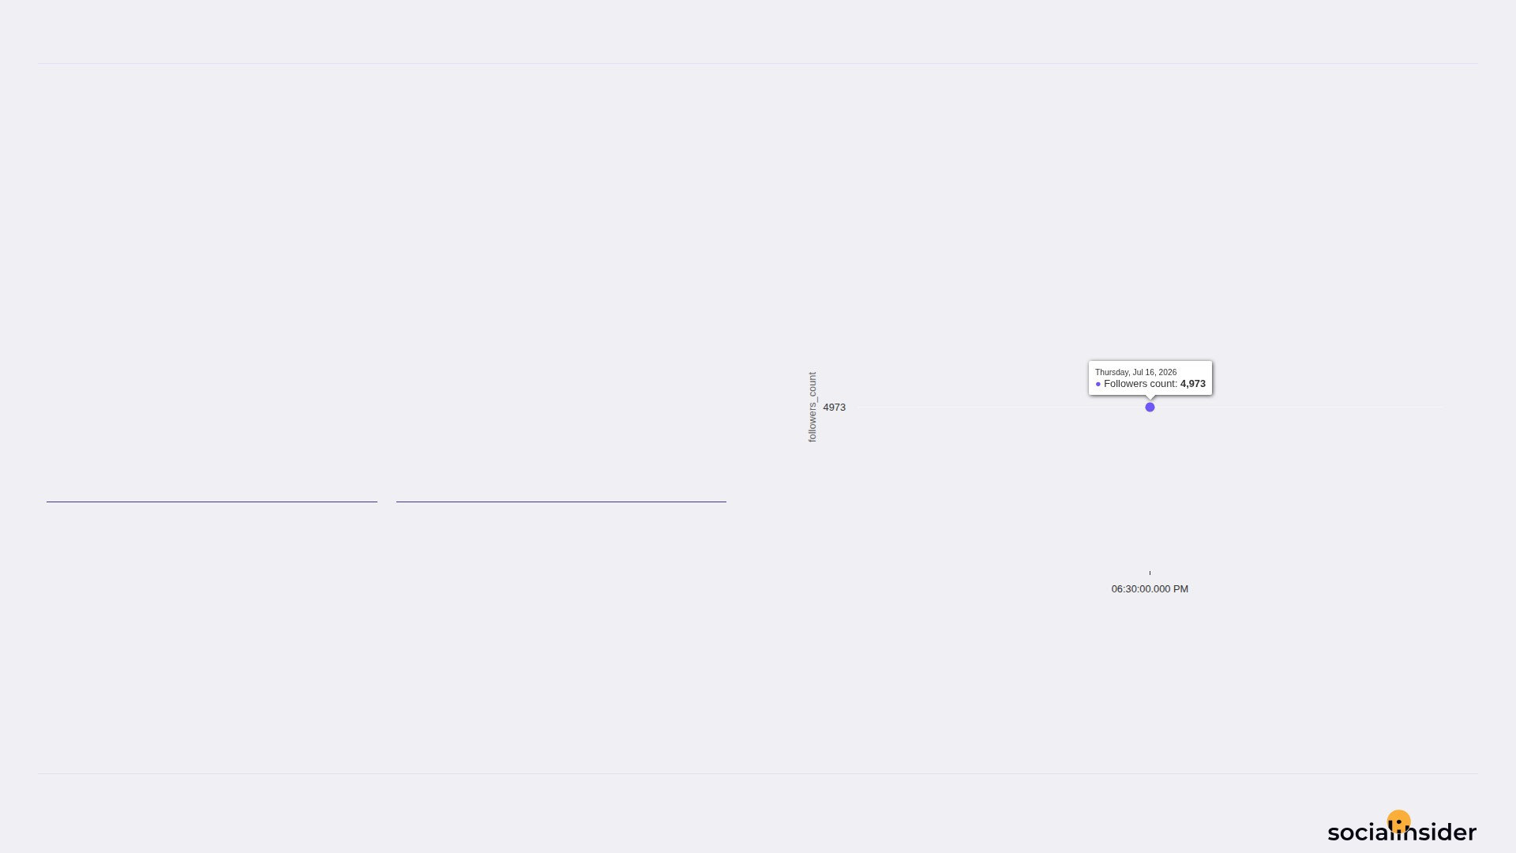
Vardhman Jewels
FOLLOWERS
11/12
Follower growth trend over the selected period
0 Follower Growth — holding steady.
Both Follower Growth and Followers Growth % declined this period.
FOLLOWER GROWTH
FOLLOWERS GROWTH %
0%
0%
Source: Socialinsider
Date range: 18 Jun 2026 - 17 Jul 2026

Slide 12

REFERENCE
12/12
Definitions and reference materials for this report
Glossary & Resources
Scope
Definitions
Resources
Period
Engagement
Socialinsider Blog
18 Jun 2026 - 17 Jul 2026
The sum of likes and comments on the organic posts
socialinsider.io/blog
Comparison Period
Engagement Rate by Followers
Socialinsider Help Center
19 May 2026 - 17 Jun 2026
Engagement divided by follower count, expressed as a percentage
https://howto.socialinsider.io/en/
Social Channel
Reach
Socialinsider Studies
Instagram
Number of unique accounts that saw your content
https://www.socialinsider.io/reports
Content Analysis (posts analyzed)
Views
12
Total number of times your content was displayed
Source: Socialinsider
Date range: 18 Jun 2026 - 17 Jul 2026

